Slide 1
Espire’s UX and UI Capabilities
June 2016

Slide 2
Introduction to Espire Design Labs

Slide 3
A complete Design consultation agency
which can answers some most difficult questions like…
Why are my visitors leaving my website or products?
What makes my users delighted?
What is that little something I can do?

Slide 4

““
UX research
UX
In a nut shell…
Usability Testing
Focus Groups
Information Architecture
UX Strategy
Creative
Creative Services
Brand Guidelines
Interaction development
W3C and Accessibility
Frontend development

Slide 5
Let’s see how we do it..
Let’s start with UX research and process of Usability Improvements

Slide 6
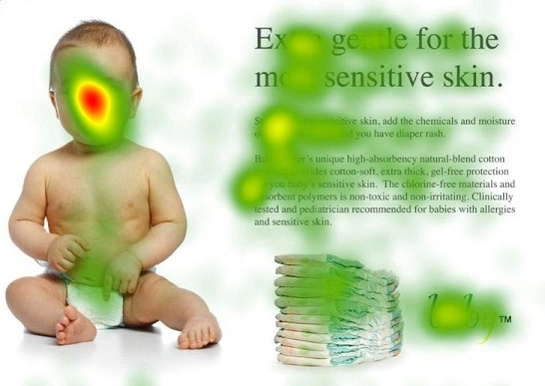
UX Research: Collecting user statistics
Heat map data of a consumer product page…
User behavior changes based on the way the graphics or imagery interact with the end user

Slide 7
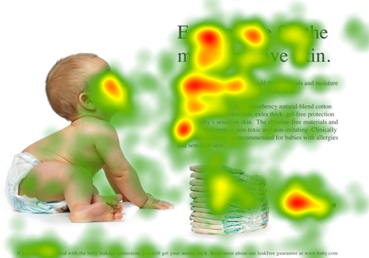
UX Research: Collecting user statistics
Heat map data of a consumer product page…
User’s attention changes based on the images used
Espire uses Google Analytics and CrazyEgg for retrieving user statistics on a particular portal, website or product.

Slide 8
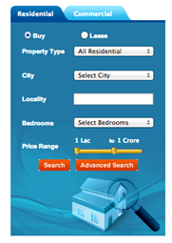
Usability: A typical case of improving search
Industry : real estate
Problem identification:
Too many clicks to reach to the search results
Too many fields to select leaving the users confused
Most users left the page mid way because of time taken to fill details and reach to results

Slide 9
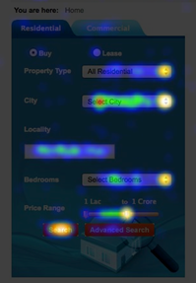
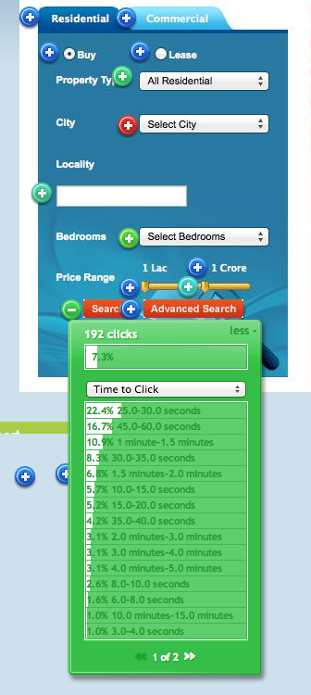
Usability: A typical case of improving search
Industry : real estate
Collecting facts and in-depth analysis
Heat map analysis to understand how much time users are taking to effectively complete a task
Heat map analysis to determine where user is clicking further giving understanding how users are treating current system and UX
Collecting data: what type of properties (e.g. 2 bed room) or BUY/RENT more popular amongst users
Exit points: understanding what’s making the user to exit the application

Slide 10
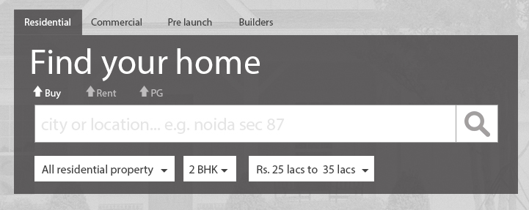
Usability: A typical case of improving search
Solution statement:
One click to reach results
Prepopulating basic fields to most commonly searched values
Focused and user oriented hierarchy of search elements
Science of spot light : Highlighting key areas with the help of right typography

Slide 11
Seeing it happen..
The conceptualization process

Slide 12

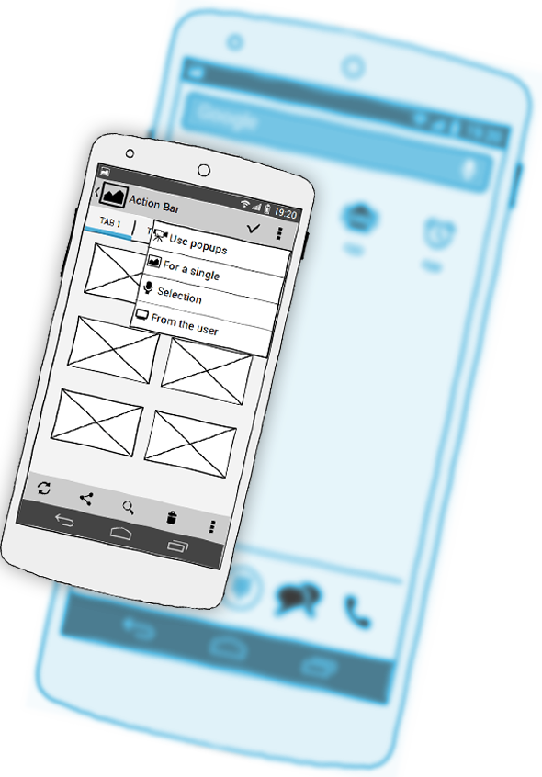
UX Design: From thoughts to blueprints
An informed customer with real-time statistics and data
From the tools shown previously, a business user is now in better position to make decisions
New strategies proposed for the customer to act
From improvements in existing applications to introducing new functions, feature or mediums such as mobile apps
UX team creates paper prototypes in discussions with customer team

Slide 13
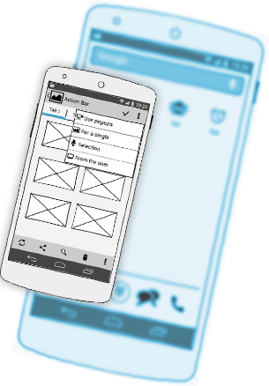
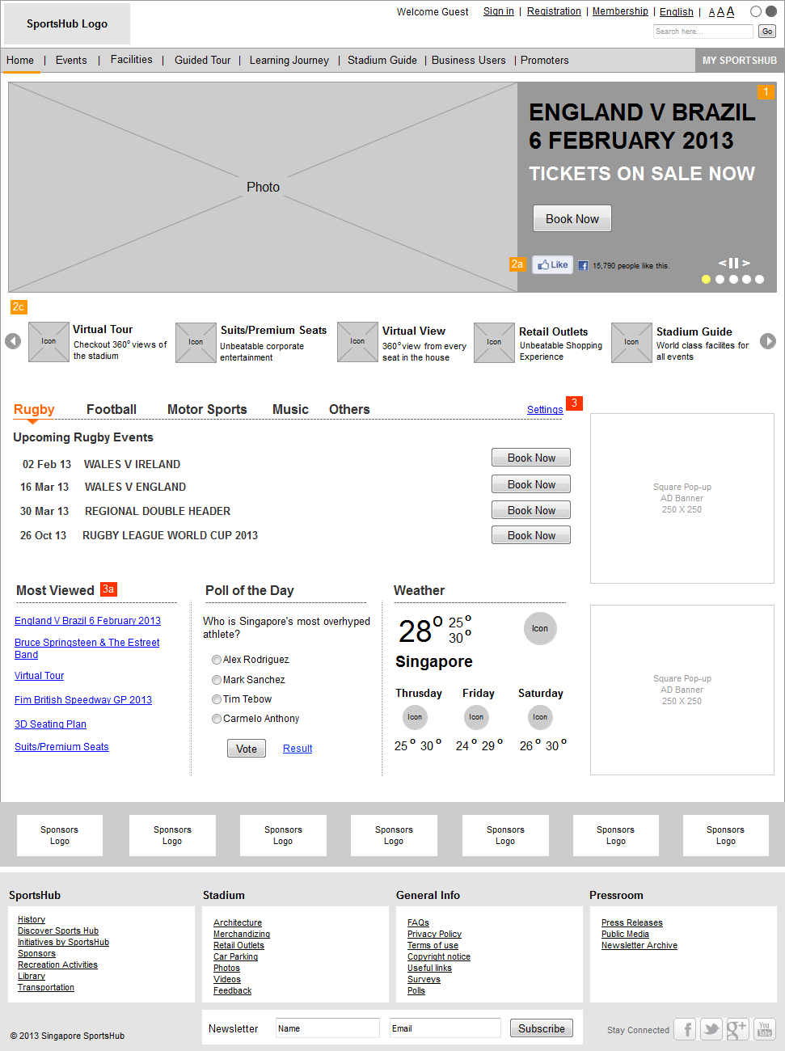
UX Design: From blueprints to interaction design
UX team creates interactive wireframes or prototype which lets the customer view the end product with complete business flow
Customer and UX team goes though reviews and usability testing cycles to reach to a final approved interaction design
Espire uses Axure and UXPIN to quickly create wireframes and interaction design

Slide 14
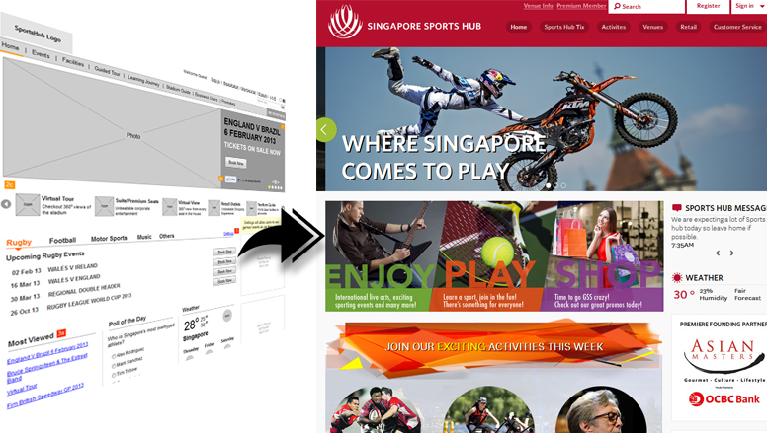
Creative Design: From interaction design to visual design
Creative team now takes over the charge and fills the right graphics and shape it as per the brand guidelines
Since the information architecture and prototype is already tested and approved, there are minimum iterations at this level
Espire uses Adobe products for creative services

Slide 15
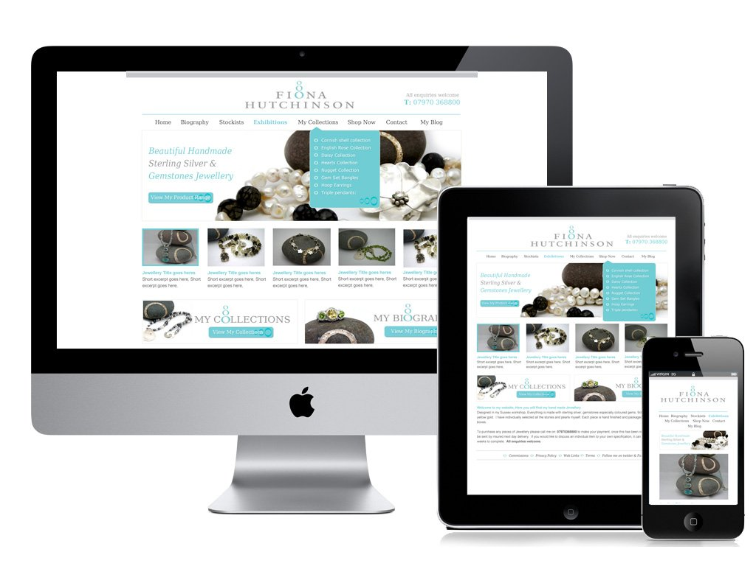
Front End Development: From visual design to working HTML5 pages
The team of expert front end developers take on to develop word class standard oriented interfaces with a list of advanced tools and technologies
Use of latest HTML frameworks such as Bootstrap, Foundation for quick templating of designs
Espire relies on various Javascript frameworks for html binding as well as CSS coding for fast loading interactive web pages
For medium such as…
All latest browsers and fallback support for older versions
Smart phones IOS, Android and windows
Tablets

Slide 16
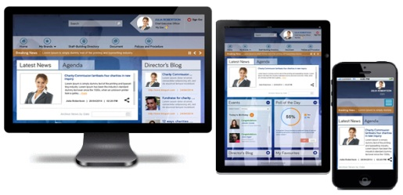




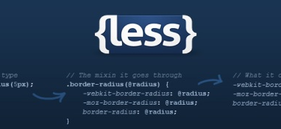



Our expertise on front end development
HTML5 Responsive Development Latest HTML5 frameworks JQuery & Other client side development CSS Less Framework Angular JS Framework

Slide 17
HTML binding frameworks
Jquery extensively used for
Smooth interaction development
Animations
Validations
Handling data elements through JSON
Backbone and Angular enables to
Making presentation layer separated from data
Best for multiple server side hits and makes smooth data flow in the applications as per user interaction
Smart usage of API’s through predefined classes and data objects
Compatible with various technology platforms such as Tridion, Sitecore or PHP based open source CMS’s

Slide 18
CSS frameworks
CSS LESS
Enables you to define reusable code with the help of variables
More structured and less redundant code
SASS and COMPASS
Enables to creates functions with CSS to be used at different places for different needs
Same function can be used as per argument passed e.g. A single function for border radius can be used for different border sizes
COMPASS is a library of predefined functions which gives you a pre set environment to quickly create web pages. These preset functions are well written and to be used for important features like browsers tests, devices tests etc.

Slide 19



Code compliance
W3C validated code (AA level) as a standard compliance across the projects
Accessibility validations of code (AA level) as per WAI guidelines
Accessibility validations as per country specific standards e.g. Section 508 for US and UK Government Accessibility Standards Guidelines

Slide 20
Our talent pool…

Slide 21
UX
COE
ESPIRE
DESIGN
LAB
Front end developers
User researchers
Content strategists
Interaction designers
Visual designers

Slide 22
Let’s see how we communicate the design process
Introduction to dedicated design lab portal

Slide 23
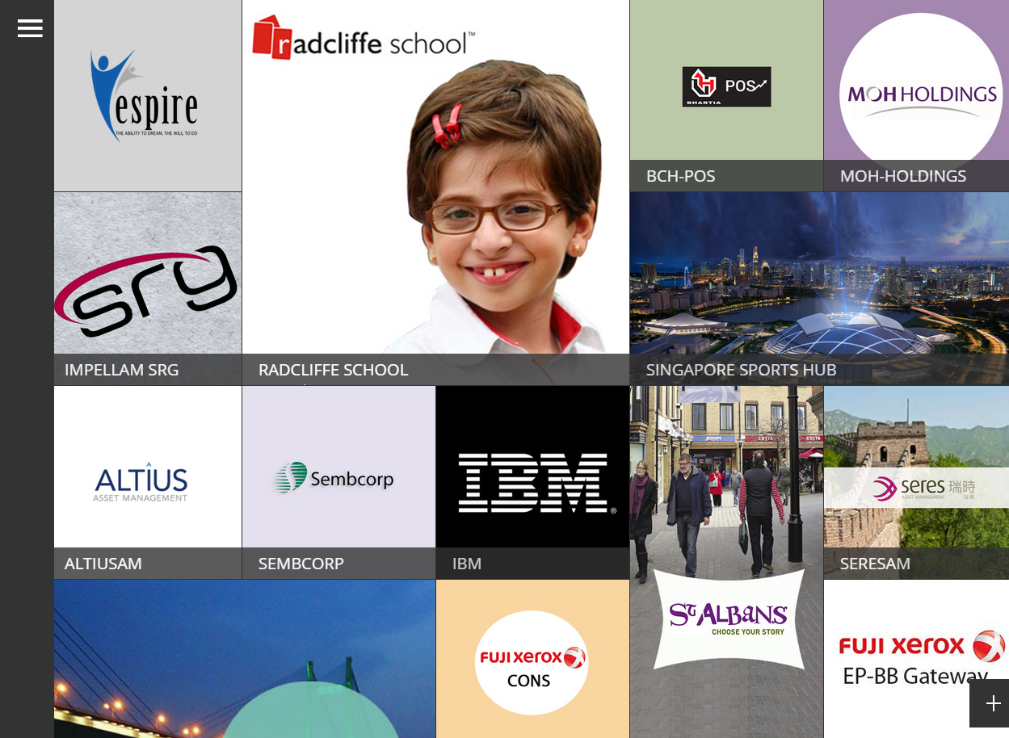
Espire design lab portal

Slide 24
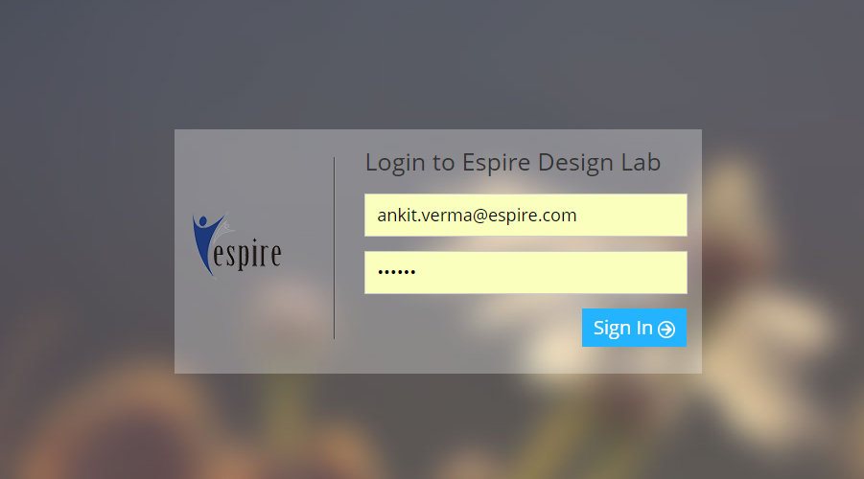
Espire design lab portal
Secure Access: http://designlab.espire.com/admin
Login as:
Client
Sales team
UX team
UX COE (Admin)

Slide 25
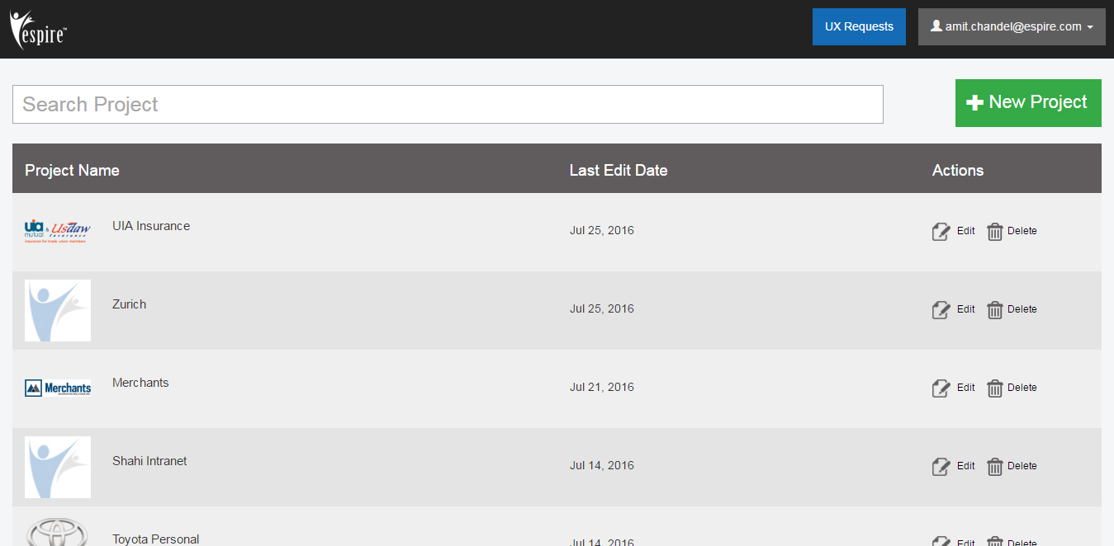
Espire design lab portal

Slide 26
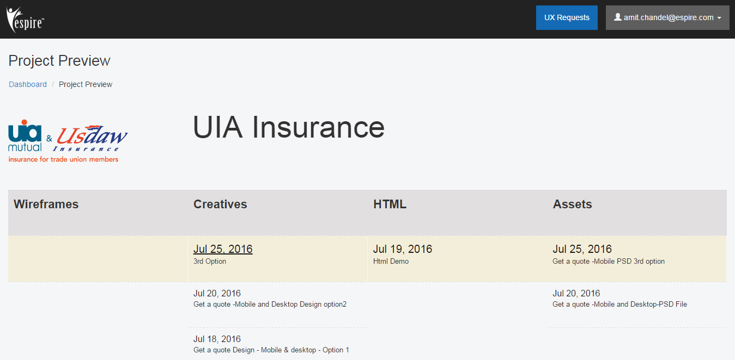
Espire design lab portal

Slide 27
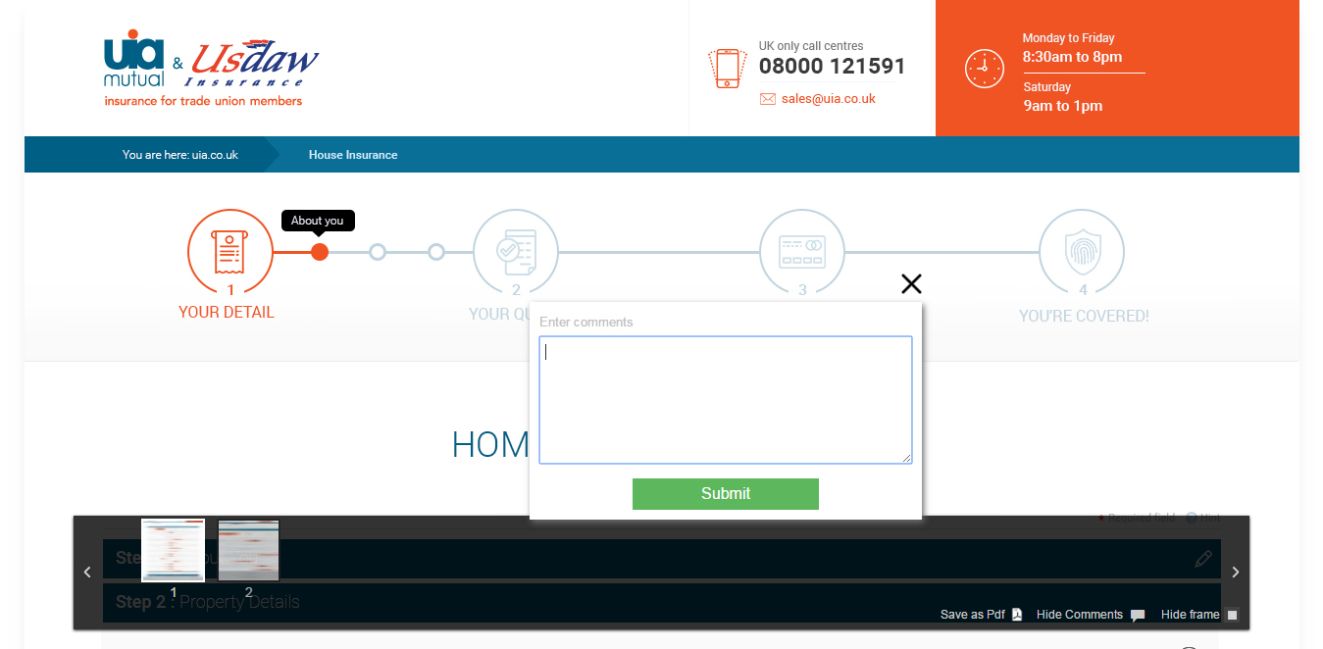
The Design communication on DesignLab: Discussing designs were never so easy with live and to the point commenting

Slide 28
Discussion
Understand UIA’s expectations
Identify any gap and how to bridge it.
Next steps.

Slide 29
Some more interesting case studies..
http://designlab.espire.com/
please ask our representative for the guest credentials to login and have a look at the vast portfolio….

Slide 30
Thanks

